Slide 1

AI Automation Framework
Design Principles
Explore the foundational principles guiding our AI-driven automation framework, engineered for clarity, scalability, and operational intelligence.

Slide 2
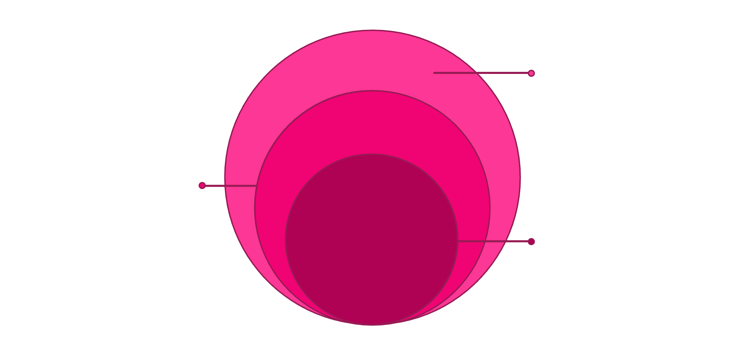
Chapter 1
Layered Intelligence Architecture
The system is structured into distinct layers: User Interaction, AI Decision Engine, Workflow Automation, Data Storage, and Dashboard Visualization. This design promotes clarity, maintainability, and a clean separation between intelligence, execution, and presentation layers.
Workflow Automation
Orchestrates tasks and triggers
AI Decision Engine
Models that generate recommendations
User Interaction
Interfaces for input and feedback
Each layer operates independently yet integrates seamlessly, allowing for focused development and easier troubleshooting.
This modular approach ensures clear separation of concerns, enhancing maintainability and scalability across all system components.

Slide 3


Conversational-First Design
Natural Language Interaction
Intent Interpretation
Operational Efficiency
The AI Agent is designed to interpret user intent accurately, translating conversational input into structured automation triggers.
This conversational approach significantly reduces operational friction and enhances overall usability, making the system accessible to a broader user base.
Both the Stock and Project systems are built around intuitive natural language interaction, allowing users to communicate intent without complex manual data manipulation.

Slide 4
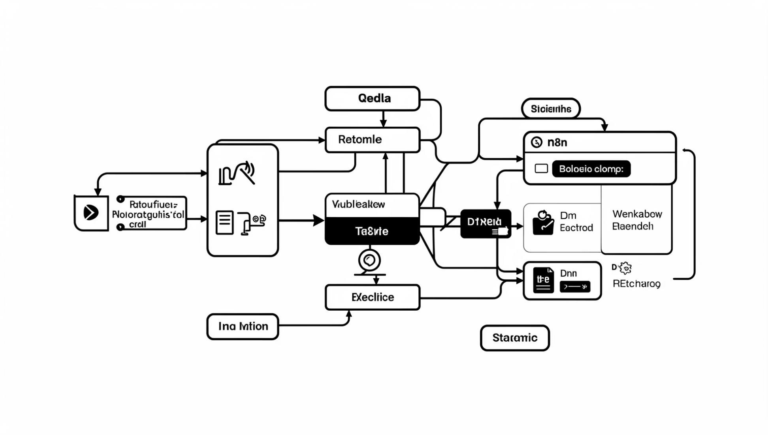
Chapter 2
Automation-Centric Execution
The n8n workflow engine serves as the central orchestration layer for our framework. It ensures a robust and controlled execution environment by managing:
Structured CRUD Operations: Enabling reliable creation, reading, updating, and deletion of data.
Controlled Data Updates: Implementing safeguards for data integrity and consistency.
Expandable Automation Logic: Providing a flexible foundation for evolving and adding new automation sequences.
This focus on automation means the system operates autonomously, minimising manual intervention and maximising efficiency.

Slide 5

Data-Driven Decision Visibility
Our framework integrates Google Sheets as a structured data layer, providing a reliable source for operational data.
Real-time Metrics
Visual Analytics
Operational Insights
Synchronised Data Flow
Lovable dashboards offer immediate access to key performance indicators, ensuring decisions are based on current data.
Complex data is translated into clear, intuitive visualisations, making trends and insights easily digestible for stakeholders.
Dashboards provide deep operational insights, revealing bottlenecks and opportunities for improvement.
Data updates and dashboard visualisations remain perfectly synchronised, ensuring accuracy and consistency.

Slide 6
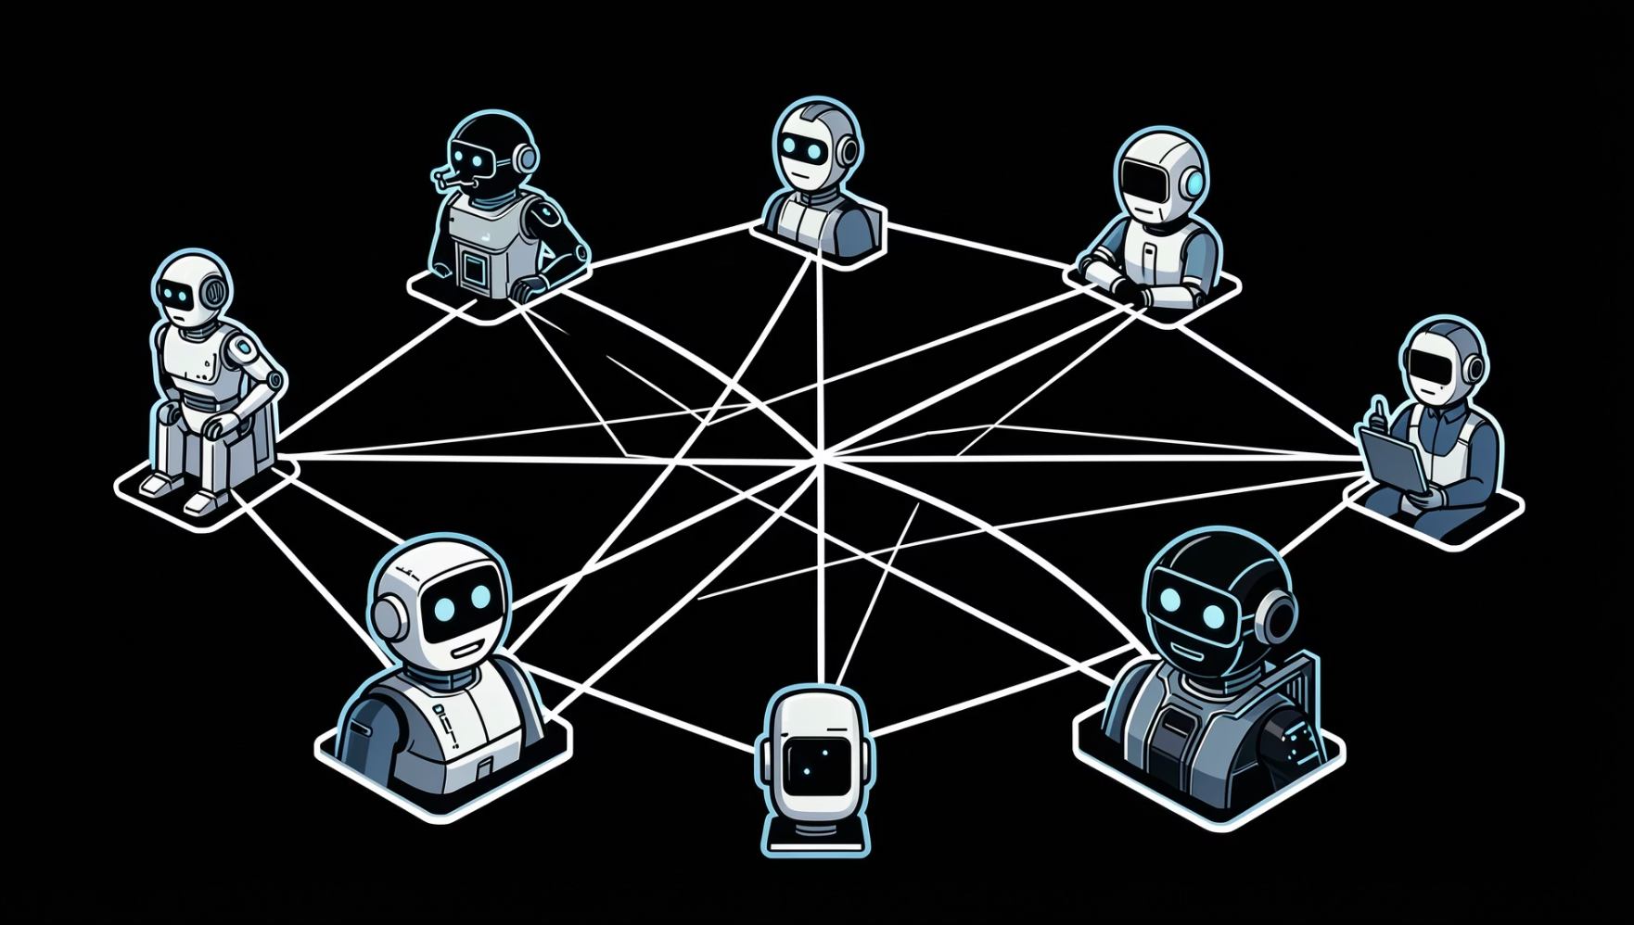



Chapter 3
Extensible Multi-Agent Vision
The current implementation strategically includes two specialised agents: the Stock Agent and the Project Agent. These serve as foundational components within our AI automation framework.
Our architecture is specifically designed for future expansion, supporting the seamless integration of additional agents to create a comprehensive and collaborative multi-agent ecosystem.
Planned Agent Expansion
Analytics Agent
Monitoring Agent
Reporting Agent
For deep data analysis and predictive insights.
To track system performance and alert on anomalies.
Automating report generation and distribution.

Slide 7
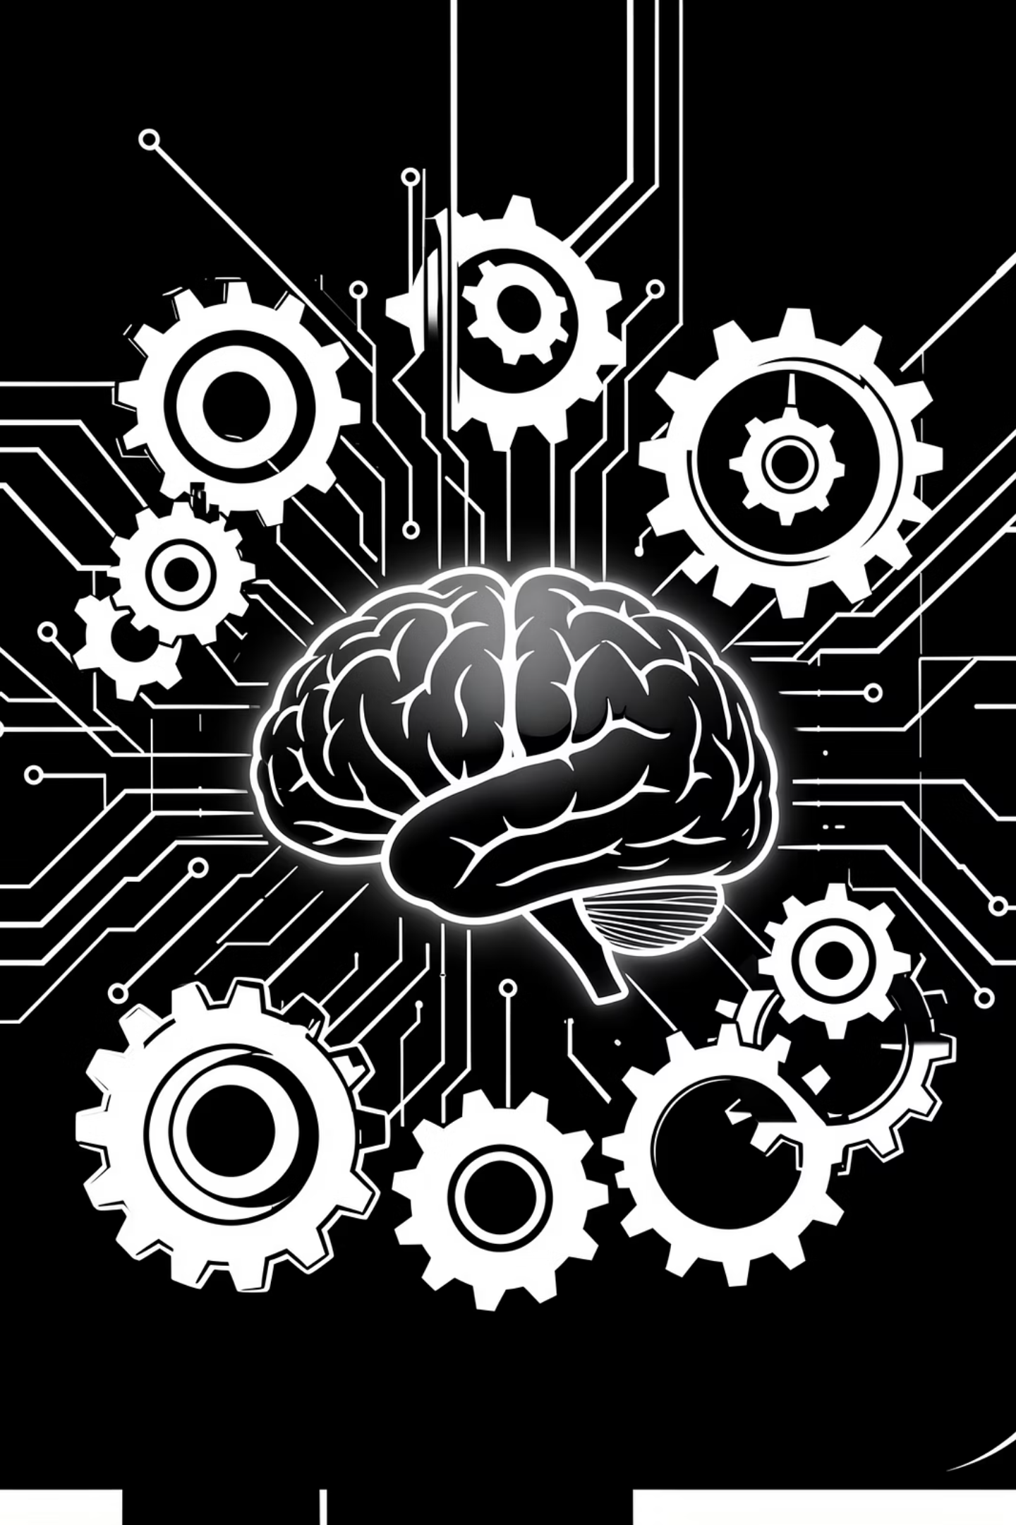
A Scalable AI-Driven Automation Framework
The system is not built as isolated applications, but as a scalable AI-driven automation framework designed for structured expansion and operational intelligence.
It embodies a holistic approach to automation, ensuring agility and future-proofing our operations.

Slide 8

KEY PRINCIPLE
Automation-Centric Execution
At the core of our AI automation framework is the n8n workflow engine, functioning as the primary orchestration layer. Its role is pivotal in ensuring highly efficient and controlled operational processes.
Key functionalities include the assurance of structured CRUD operations, guaranteeing data integrity and consistency. It also enables controlled data updates to prevent discrepancies and facilitates expandable automation logic, allowing for the agile development and integration of new workflows.
This ensures the system is inherently automation-driven, significantly reducing reliance on manual processes and enhancing overall operational effectiveness.

Slide 9



FUTURE GROWTH
Extensible Multi-Agent Vision
Analytics Agent
Monitoring Agent
Reporting Agent
Designed to provide deep data insights and predictive modelling capabilities.
Focused on real-time system health checks and performance optimisation.
Automating comprehensive report generation for various stakeholders.
The current framework, featuring the Stock and Project agents, is merely the beginning. Our strategic vision includes expanding into a robust multi-agent ecosystem, with the planned integration of Analytics, Monitoring, and Reporting Agents. This modular architecture is designed for seamless growth, enabling a collaborative and increasingly intelligent operational environment.

Slide 10

A Unified Framework for Operational Intelligence.
Our AI-driven automation framework represents a paradigm shift from isolated applications to a cohesive, scalable ecosystem. It is engineered for structured expansion, ensuring that every new component enhances overall operational intelligence and contributes to a more efficient and agile future.

